Slide 1

Credit Card Fraud Detection:
Using State-of-the-Art Machine Learning and Deep Learning Algorithms
ALBIN SABU PROJECT GUIDE MLM23MCA-2008 MS DIVYA S B
HOD&ASSOCIATE PROFESSOR

Slide 2
Introduction
Implements state-of-the-art Machine Learning and Deep Learning techniques for fraud detection.
Analyzes transactional patterns to differentiate between legitimate and fraudulent activities.
Automates fraud identification, minimizing manual review efforts.
Enhances security by reducing false positives and improving fraud detection accuracy.

Slide 3
PROJECT PLAN
Research: Data collection and literature review – December 2024
Design Phase: Model architecture design – January 2025
Implementation: ML and DL models applied – February 2025
Testing: Performance evaluation – March 2025
Deployment: Integration into a fraud detection system – April 2025

Slide 4
SCOPE
Fraud Detection: Identifying fraudulent transactions using ML and DL models.
Automated System: A real-time fraud detection mechanism.
Data Analysis: Use of European credit card transaction datasets.
Feature Selection: Ranking top transaction features for fraud detection.
Performance Optimization: Balancing data to minimize false negatives and improve precision.

Slide 5
PROBLEM DEFINITION
To develop an efficient fraud detection system that minimizes financial losses by accurately detecting fraudulent transactions and reducing false-positive and false-negative rates.

Slide 6
LITERATURE REVIEW
TITLE | AUTHOR | YEAR | FINDINGS
Credit Card Fraud Detection Using State-of-the-Art Machine Learning and Deep Learning Algorithms | Fawaz Khaled Alarfaj, Iqra Malik, Hikmat Ullah Khan, Naif Almusallam, Muhammad Ramzan, Muzamil Ahmed | 2022 | Proposed CNN-based deep learning models for fraud detection, achieving 90.9% accuracy and outperforming traditional ML algorithms in precision and recall.
An Efficient Real-Time Model for Credit Card Fraud Detection Based on Deep Learning | Y. Abakarim, M. Lahby, A. Attioui | 2018 | Introduced a real-time fraud detection system leveraging DL algorithms, demonstrating improved performance in fraud detection over traditional approaches.
Credit Card Fraud Detection Model Based on LSTM Recurrent Neural Networks | I. Benchaji, S. Douzi, B. E. Ouahidi | 2021 | Presented a model using LSTM networks, achieving high accuracy and better handling of time-sequential data in credit card fraud detection.
Fraud Detection for Job Placement Using Hierarchical Clusters-Based Deep Neural Networks | J. Kim, H.-J. Kim, H. Kim | 2019 | Proposed a hierarchical cluster-based DNN for fraud detection, achieving effective classification with reduced false positives.
A Survey on Credit Card Fraud Detection Using Machine Learning and Deep Learning | . Lucas, J. Jurgovsky | 2020 | Reviewed state-of-the-art ML and DL methods, highlighting CNN and GAN as top-performing models for fraud detection applications.

Slide 7
REQUIREMENT ANALYSIS
Frontend: Web-based dashboard for fraud detection alerts.
Backend: Python with Tkinter Tensor flow for API integration.
Database: MySQL for storing transaction data.
Software Tools: Anaconda, TensorFlow, Scikit-Learn.

Slide 8
FUNCTIONAL REQUIREMENTS
User Authentication: Secure access for authorized users to prevent unauthorized transactions.
Fraud Detection System: Analyzes transaction patterns using Machine Learning (ML) and Deep Learning (DL) models.
Real-time Transaction Monitoring: Detects fraudulent transactions dynamically and flags them for review.
Alert & Notification System: Sends alerts to users and financial institutions for suspicious transactions.
Model Training & Updating: Continuously trains and updates models with new fraud patterns to enhance accuracy.
Reporting & Analytics: Generates reports on model performance.

Slide 9
NON FUNCTIONAL REQUIREMENTS
Performance: Real-time fraud detection with minimal latency.
Scalability: Ability to handle growing transaction volumes with cloud-based deployment.
Usability: User-friendly dashboard for financial analysts and security teams.
Security: Implement strong encryption and multi-factor authentication to protect transaction data.
Reliability: uptime with fault tolerance and automatic recovery mechanisms.

Slide 10
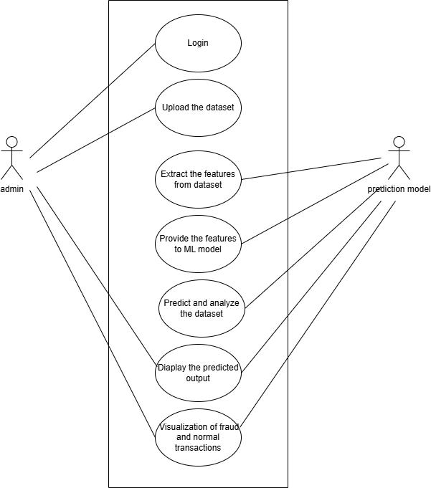
USE CASE

Slide 11
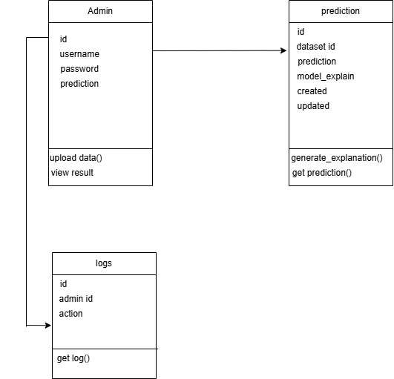
CLASS DIAGRAM
+id : int()
+name : varchar(
+email : varchar()
+password : varchar()
+id : int()
+user_id : int()
+result : varchar()
+date : date()
()
Predict()

Slide 12
DFD LEVEL 0
CREDIT CARD FRAUD DETECTION
ADMIN
request
PREDICTION MODEL
response

Slide 13
DFD LEVEL 1-ADMIN
CREDIT CARD DETAILS UPLOAD
ADMIN
request
LOGIN
response
PREDICT
PREDICT_+ID

Slide 14
MODULE DESCRIPTION
ADMIN
Upload the credit details
Predict
View result

Slide 15
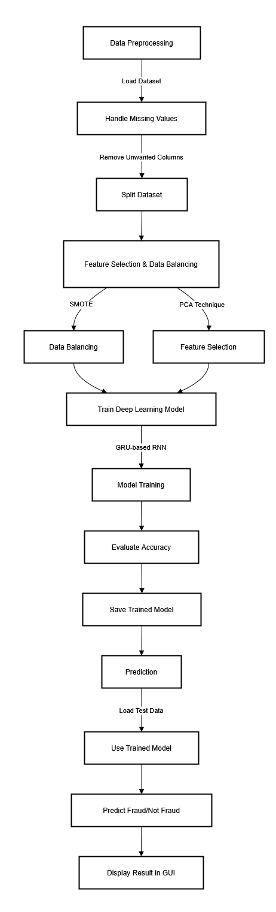
ARCHITECTURE

Slide 16
RESULT AND ANALYSIS
- Accuracy: 95.00%
- Precision: 91%
- Recall: 85.71%
- F1-Score: 90.12%
Deep learning models significantly outperformed traditional machine learning approaches.

Slide 17
CONCLUSIONS
Credit Card Fraud Detection achieved high accuracy using machine learning and deep learning models.
Deep Learning (DL) models like RNN outperformed traditional methods in fraud detection.
Feature selection techniques enhanced model performance by identifying crucial transaction attributes.
Challenges remain in real-world deployment, especially in handling class imbalance in fraud datasets.
Future work will focus on refining DL models, improving fraud detection accuracy, and reducing false positives​

Slide 18
FUTURE SCOPE
Enhancing Model Performance
Optimize machine learning and deep learning architectures for higher fraud detection accuracy.
Fine-tune hyperparameters to improve generalization and reduce false positives.
Advancing Explainability (XAI)
Integrate Explainable AI (XAI) methods to enhance fraud detection transparency.
Utilize LIME, SHAP, or attention mechanisms to provide insights into model decisions.
Expanding Dataset & Real-World Testing
Incorporate larger and more diverse credit card fraud datasets for robust training.
Validate models on real-time transaction data to assess effectiveness in real-world scenarios.
Integration with Financial Systems
Develop a user-friendly fraud detection dashboard for financial institutions.
Ensure compliance with financial security regulations to enable real-world adoption.

Slide 19
REFERENCES
A. D. Pozzolo, O. Caelen, R. A. Johnson, and G. Bontempi, ‘‘Calibrating probability with undersampling for unbalanced classification,’’ in IEEE Symposium Series on Computational Intelligence (SSCI), 2015, pp. 159–166.
A. Dal Pozzolo, O. Caelen, Y. Le Borgne, S. Waterschoot, and G. Bontempi, ‘‘Learned lessons in credit card fraud detection from a practitioner perspective,’’ Expert Systems with Applications, vol. 41, no. 10, pp. 4915–4928, 2014.
M. Taha and J. Malebary, ‘‘An intelligent approach to credit card fraud detection using deep learning with feature selection and hyperparameter optimization,’’ IEEE Access, vol. 8, pp. 165024–165038, 2020.
E. Duman and M. H. Ozcelik, ‘‘Detecting credit card fraud by genetic algorithm and scatter search,’’ Expert Systems with Applications, vol. 38, no. 10, pp. 13057–13063, 2011.

Slide 20

DEMO VIDEO

Slide 21
THANK YOU

